Slide 1
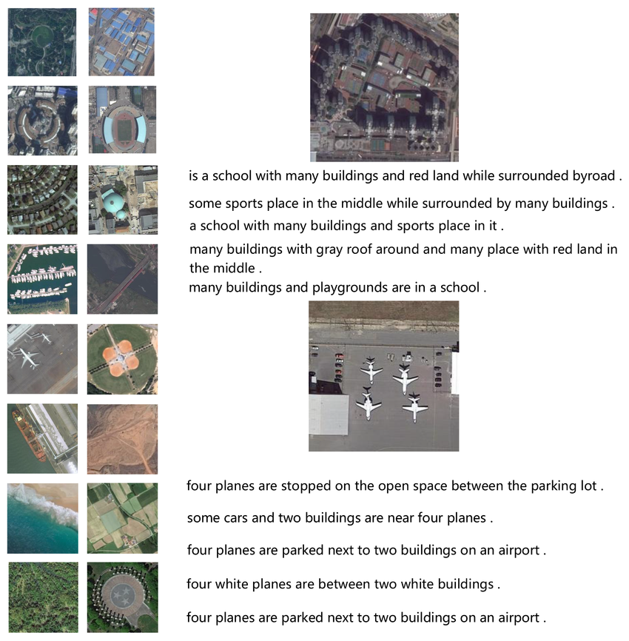
Surveyed Approach to
Remote Sensing Image Caption Generation Using the RSICD Dataset
COMP9444 Project
Shayan ziaei (z5527663)
Pankaj Patel (z5519861)
Revathi Sridhar Surya (z5520480)
Sachin Singh (z5525041)
Jason Widjaja (z5494973)
Code Geass

Slide 2
Motivation
“How do we teach AI to describe the Earth from Above”
Presenter: Shayan ziaei (z5527663)

Slide 3
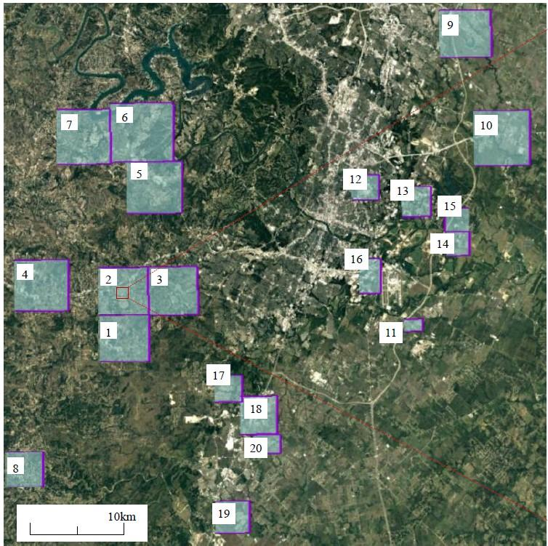
Applications include:
Environmental monitoring:
Describe changes in land use or vegetation.
Urban planning:
Identify buildings, roads, and land zones automatically.
Disaster response:
Summarize damage after floods, fires, or earthquakes.
Military/surveillance:
Quickly understand what's in a satellite image.
Agriculture:
Detect crop types or field layouts using captions.
Presenter: Shayan ziaei (z5527663)

Slide 4
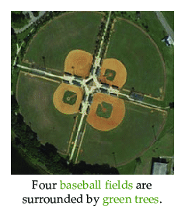
So our goal is …
To create a model that generates accurate and coherent captions for remote sensing images on RSCID dataset (e.g., “Four baseball fields are surrounded by green trees”).
To address the challenges of scale, category, and rotation ambiguities inherent in remote sensing images.
Presenter: Shayan ziaei (z5527663)

Slide 5
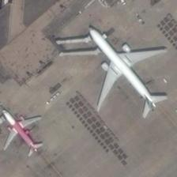
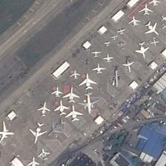
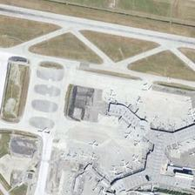
Challenge 1: Scale variation
Objects differ significantly in size (e.g., a car vs. a runway). Each image is quite small 224 x 224
Easy
Medium
Hard: Multi-object scenes
00493.jpg
airport_245.jpg
airport_234.jpg
Presenter: Shayan ziaei (z5527663)

Slide 6
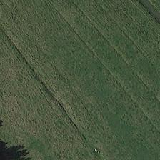
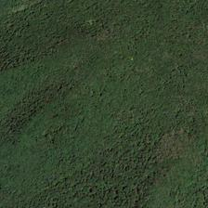
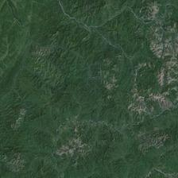
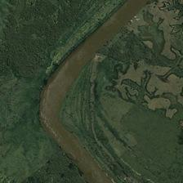
Challenge 2 Semantic ambiguity:
Visually similar textures may represent different categories (e.g., meadow vs. farmland).
meadow_145.jpg
forest_214.jpg
mountain_126.jpg
river_200.jpg
is this a Farmland / Meadow / Forest / Mountain?
Presenter: Shayan ziaei (z5527663)

Slide 7
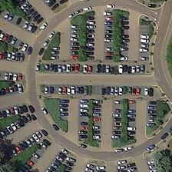
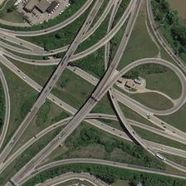
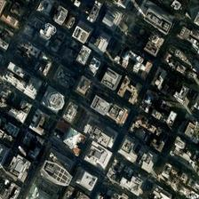
Challenge 3 Rotation ambiguity
No fixed orientation in aerial views.
Cnn based models may be rotation sensitive-Features extracted may vary with rotation
May even get different caption-> hurts the evaluation
parking_266.jpg
viaduct_357.jpg
commercial_110.jpg
Presenter: Shayan ziaei (z5527663)

Slide 8
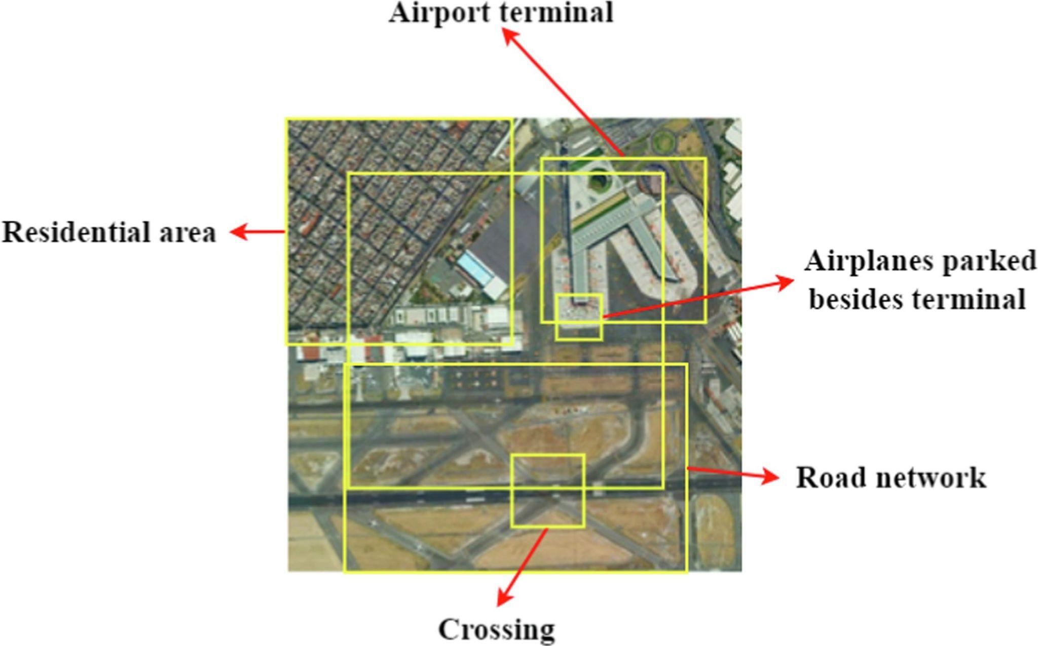
Challenge 4 Multi-object scenes:
A single image may contain roads, rivers, and buildings all at once.
airport_90.jpg
Presenter: Shayan ziaei (z5527663)

Slide 9
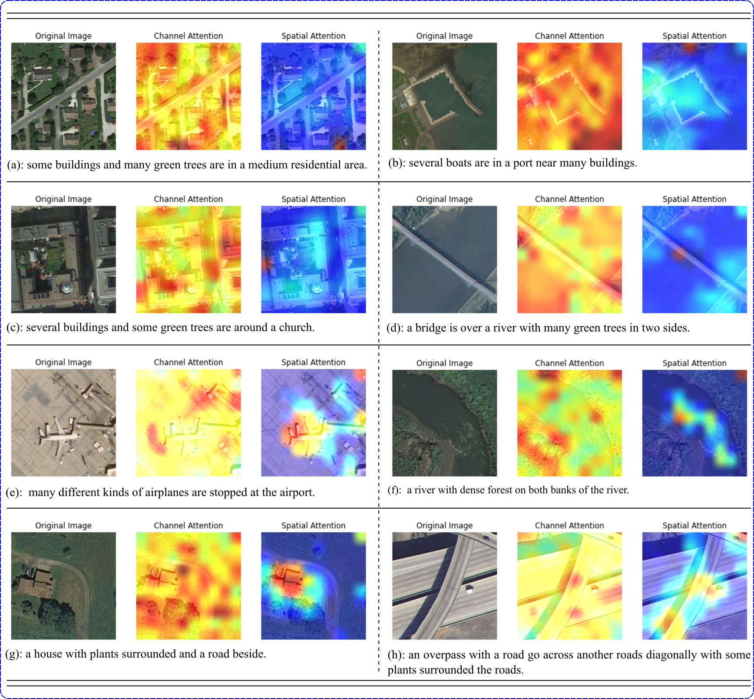
“Need a way to
focus the model”
1. Which feature are important?
2. Where in the image is important(look)?
Presenter: Pankaj Patel (z5519861)
Notes:
1:24

Slide 10
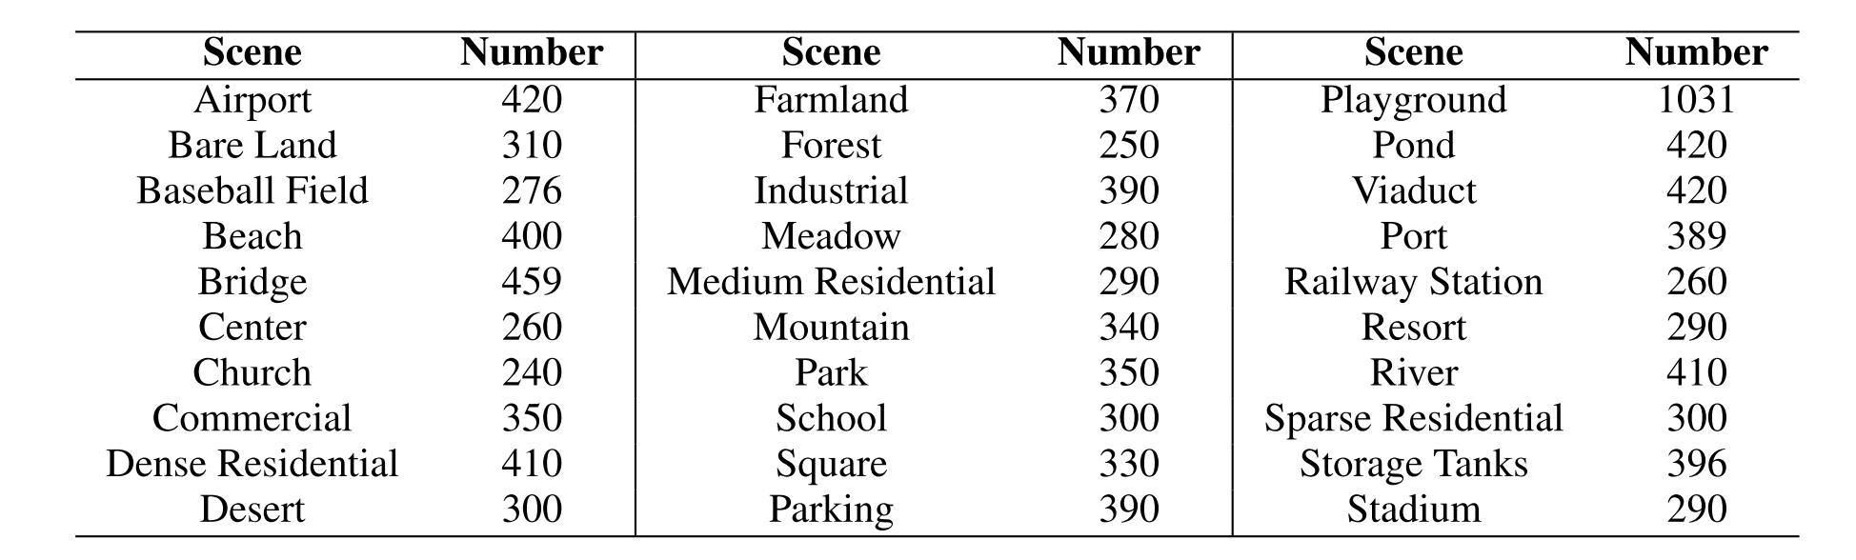
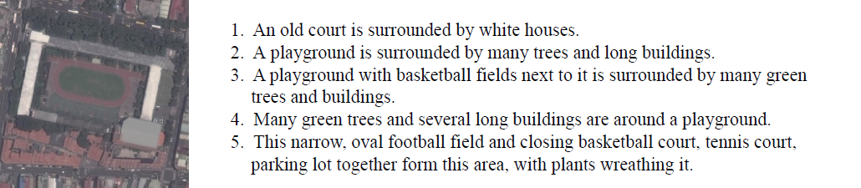
Dataset: 10921 remote sensing images (8734 Training images)
An old court is surrounded by white houses.
A playground is surrounded by many trees and long buildings.
A playground with basketball fields next to it is surrounded by many green trees and buildings.
Many green trees and several long buildings are around a playground.
This narrow, oval football field and closing basketball court, tennis court, parking lot together form this area, with plants wreathing it.
(31 classes) 10921 images x 5 captions = 54,605 image-caption pairs
Sourced from Google Earth, Baidu Map, MapABC, Tianditu (Lu et al. 2017)
Presenter: Pankaj Patel (z5519861)
Notes:
Shayn 2:45

Slide 11
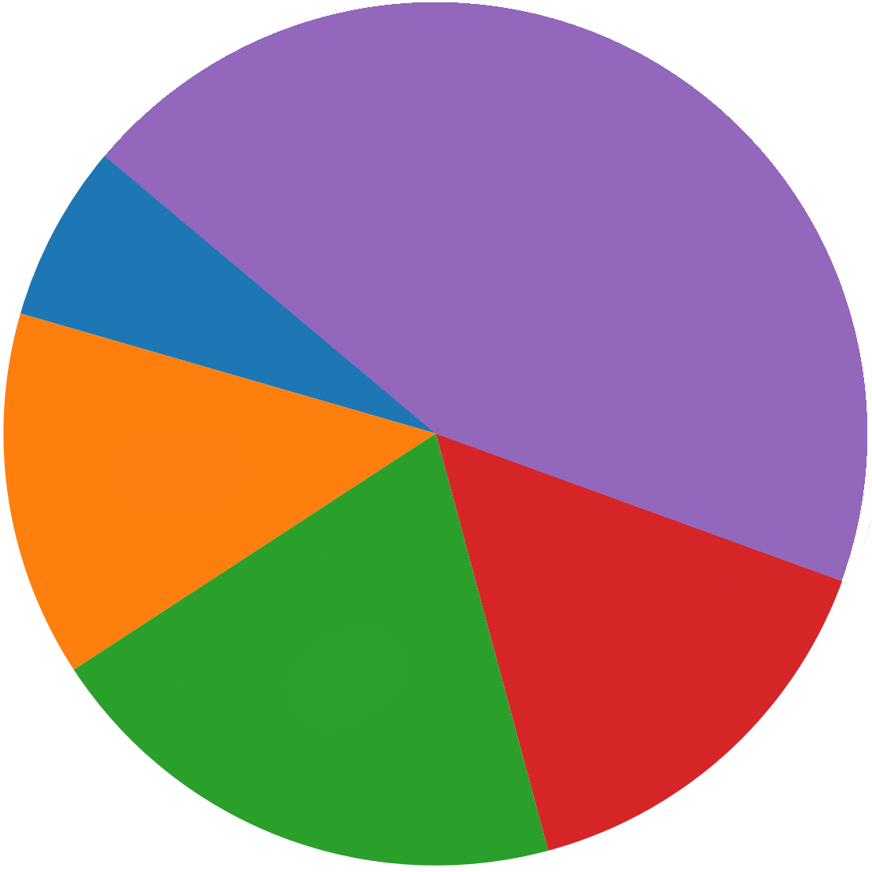
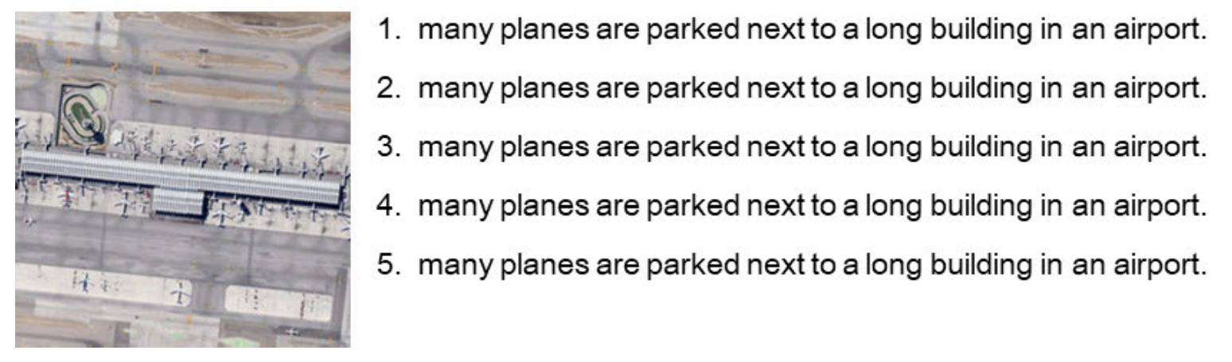
Captions Inconsistency
5 sentences
4 sentences
RSICD dataset lack flexibility and diversity, often providing similar descriptive sentences, but not indicating any intentional ordering.
1 sentence
6.6%
13.7%
44.4%
20%
15.3%
As a result metrics like BLEU (number of n-word exact match) or CIDEr easier to optimize (less linguistic variation to match).
Inflates performance due to low lexical diversity
3 sentences
2 sentences
Presenter: Pankaj Patel (z5519861)

Slide 12
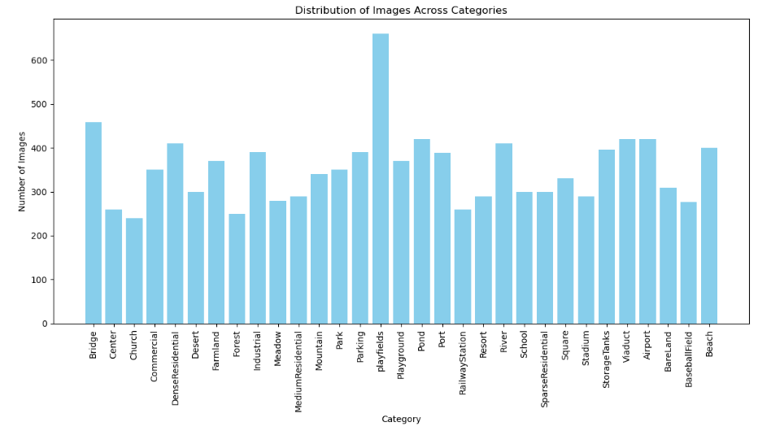
Data Analysis: Cross-split Distribution Misalignment
Figure 1: Data Distribution
Uneven distribution mean model perform good from some class and worse for some class
Validation vs. test captions differ in their textual characteristics, swapping them influences metrics.
Ref: A Benchmark for Multi-Lingual Vision-Language Learning in Remote Sensing Image Captioning
Ref: https://arxiv.org/html/2503.04592v1
Presenter: Pankaj Patel (z5519861)

Slide 13
Literature Review
Most Successful = Innovation in Attention can be in the encoder or the decoder
Period | Model(s) | Encoder | Decoder | Innovation
2017 | SAT (Lu et al., 2018) | ResNet-50 | Soft Attn + RNN | First RSIC model, RSICD release
2019 | Scene-Guided Dual-Attn | ResNet | Scene-Attn + LSTM | Category guidance, dual semantics
2020 | A2DenseNet, RL, Captioner | Dense/ ResNet | Multiscale + Dense | Layer fusion + reinforcement learning
2022 | DMSFF, MPDC | ResNet | Spatial-Channel + Dual | Multiscale and context path decoding
2024 | CapFormer, MLAT, CLIP-RSIC | ViT/CLIP | Transformer / Global | Pretrained LVLMs, full transformer
Presenter: Pankaj Patel (z5519861)

Slide 14
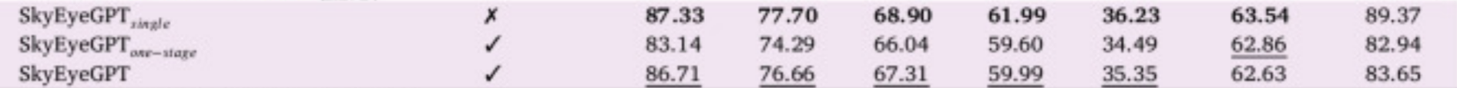
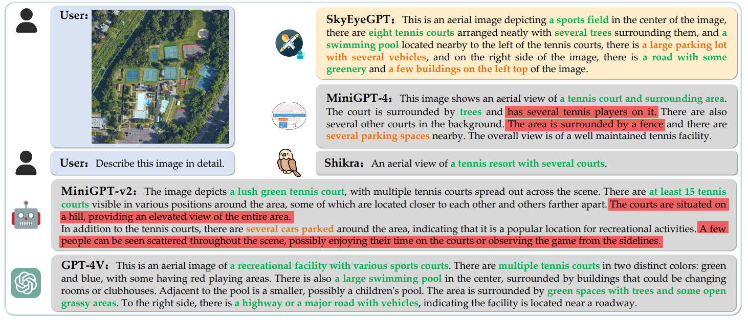
Best Model In the World SkyEyeGPT (2025)
SkyEyeGPT: Unifying remote sensing vision-language tasks via instruction tuning with large language mode
Dataset | Model(s) | open-Ended | BLEU-1 | BLEU-2 | BLEU-3 | BLEU-4 | METEOR | ROUGH_L | CIDEr
https://doi.org/10.1016/j.isprsjprs.2025.01.020
Figure 2: Skygpt evaluation result with other models for RSICD dataset
Presenter: Pankaj Patel (z5519861)

Slide 15
Selecting Base Models…
Label Atention Mecahanism (LAM) : Uses soft attention mechanisms to focus on relevant image regions while generating captions.
VIT + GPT2: Combines a Vision Transformer for image encoding with a GPT2 language model for caption generation, utilizing global attention across the entire image.
Bootstrapping Language-Image Pre-training(BLIP 1): Employs a frozen vision encoder to extract image features and a trainable language decoder for caption generation, leveraging multiple attention strategies.
Presenter: Revathi Sridhar Surya (z5520480)

Slide 16
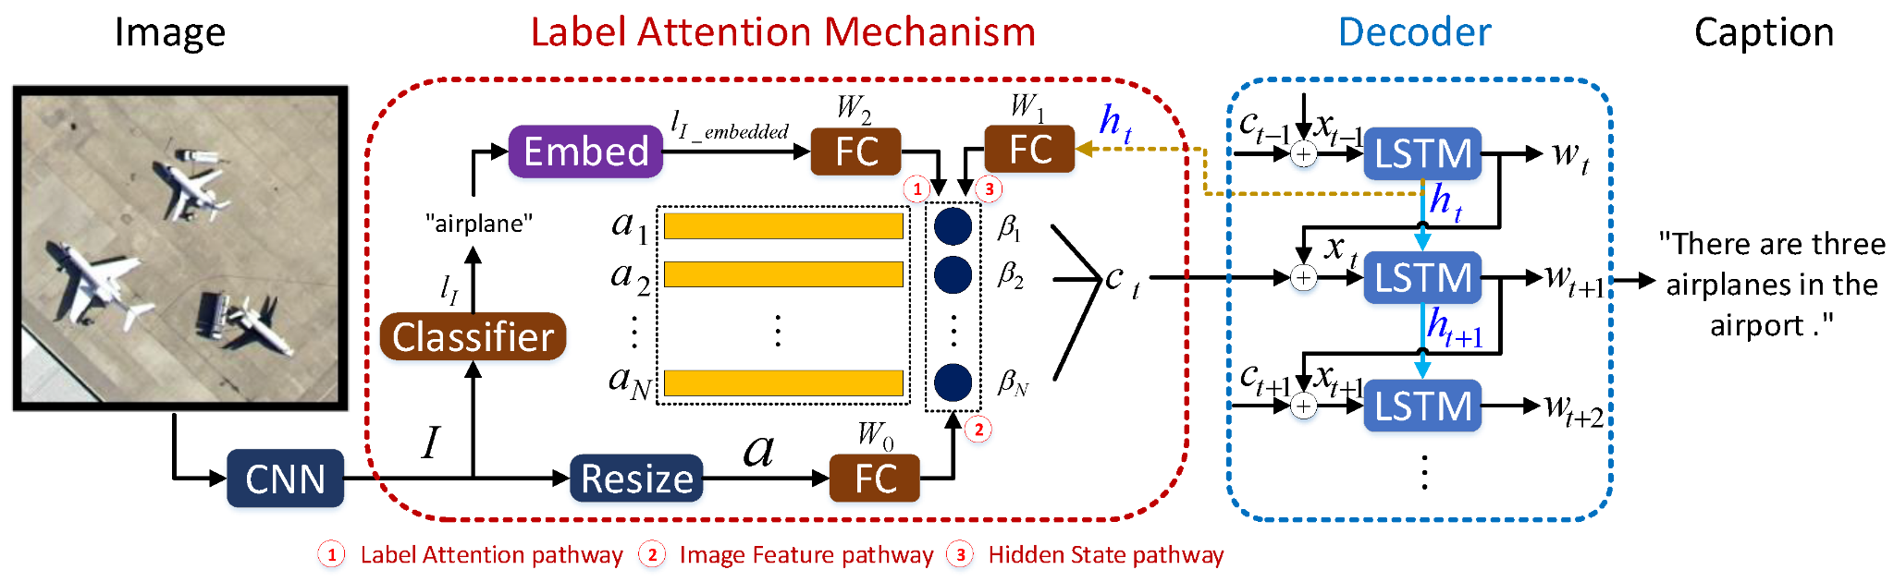
Base Model 1: LAM (ResNet151 + LSTM)
Figure 3: LAM Architecture
Encoder: Resnet151
Attention mechanism: Soft Attention
Decoder: LSTM
Presenter: Revathi Sridhar Surya (z5520480)

Slide 17
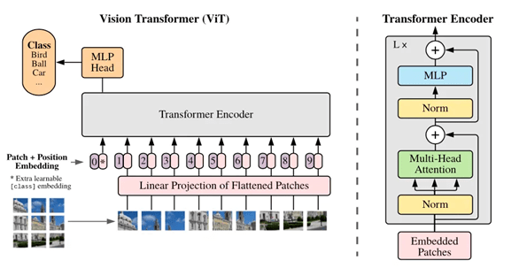
Base Model 2: Vision Image Transformer(VIT) + GPT2
Figure 5: ViT +GPT2 Model Architecture
Encoder: Vision Transformer (pre-trained)
Attention mechanism: Global Attention
Decoder: GPT2 Language model
Presenter: Revathi Sridhar Surya (z5520480)

Slide 18
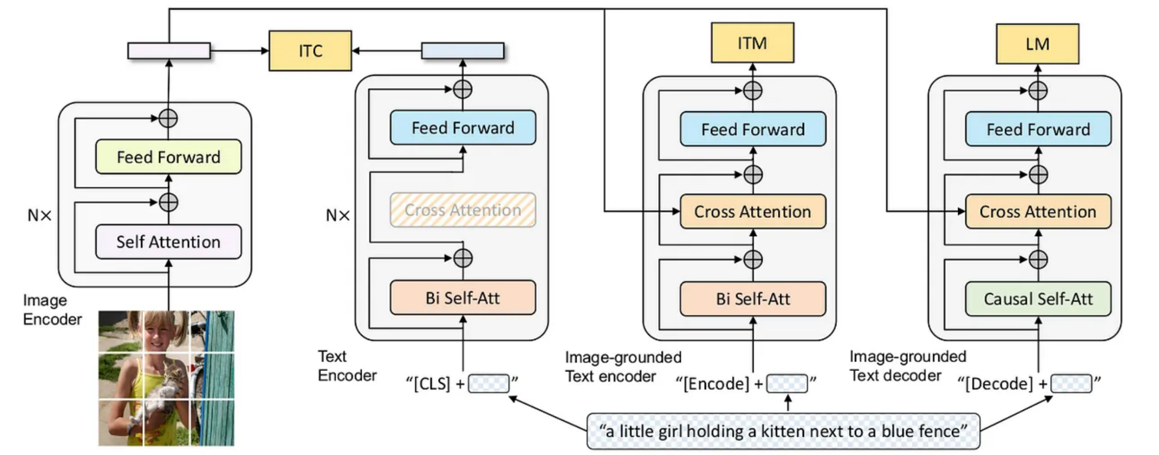
Base Model 3: BLIP 1(Salesforce)
Attention mechanism: Global Attention
Image text contrastive learning
Image text Matching
Language Modeling
Encoder: Vision Transformer
Figure 4: Blip1 Model Architecture
Decoder: BERT like architecture
Presenter: Revathi Sridhar Surya (z5520480)

Slide 19
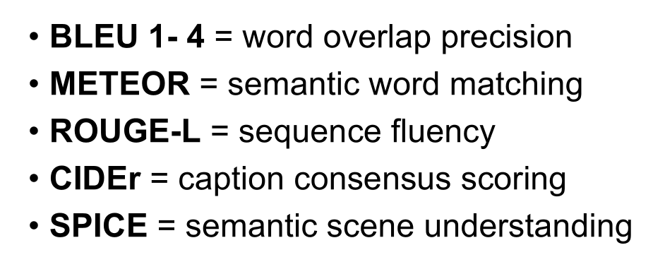
🥈
Evaluation Metrics
❌ Too rigid
1️⃣
2️⃣
✅ "jet" ≈ "plane"
Presenter: Sachin Singh (z5525041)

Slide 20
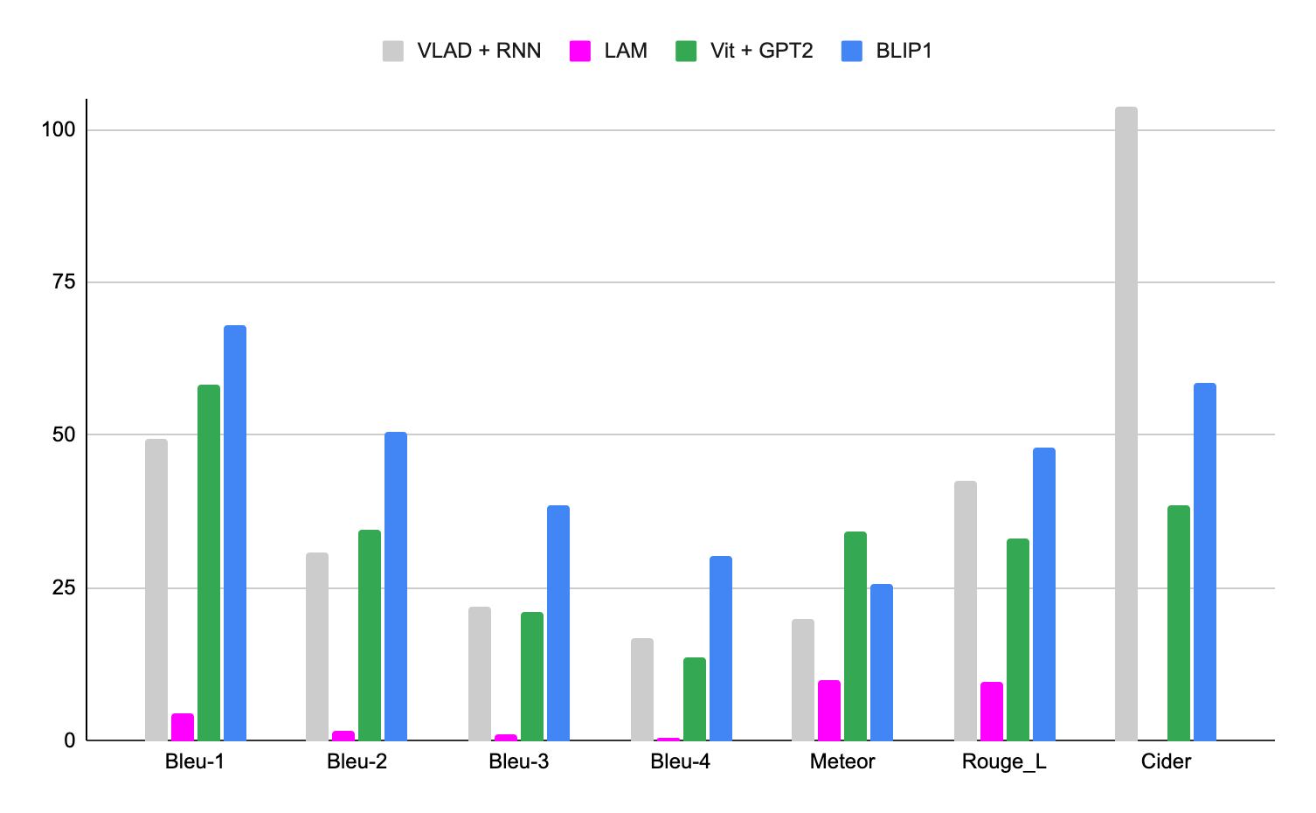
Evaluation Metrics
Figure 6: Evaluation Matrix(all model)
Models | Bleu-1 | Bleu-2 | Bleu-3 | Bleu-4 | Meteor | Rouge_L | Cider | SPICE
VLAD + RNN | 49.3 | 30.91 | 22.09 | 16.77 | 19.96 | 42.42 | 103.92 | -
LAM | 4.6 | 1.78 | 0.98 | 0.62 | 9.8 | 9.67 | - | -
BLIP1 | 68.09 | 50.71 | 38.65 | 30.27 | 25.79 | 47.94 | 58.64 | 26.71
VIT + GPT2 | 58.32 | 34.56 | 21.18 | 13.71 | 34.13 | 33.06 | 38.46 | 21.24
Presenter: Sachin Singh (z5525041)

Slide 21
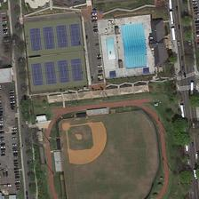
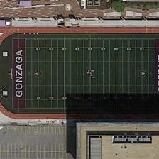
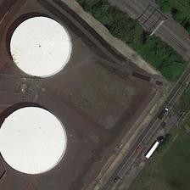
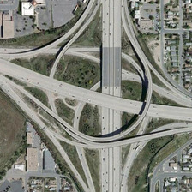
Caption Comparisons
Real-World Use > BLEU
Presenter: Sachin Singh (z5525041)

Slide 22
Easy Captioning - clear identifiable structure, color identification
Image: 00493.jpg
“a red and white small plane and a silver-white plane are parked at their gate.”
“a white plane and a pink plane are on an airport.”
“a white plane and a pink plane are parked on an airport.”
“two planes are parked in the airport.”
“a white plane and a pink plane are parked on an airport.”
LAM | a large plane is parked on the runway.
BLIP1 | two planes are near a terminal in a large airport ✅
VIT + GPT2 | planes are parked in an airport .
Presenter: Sachin Singh (z5525041)

Slide 23
Medium Captioning - spatial context ‘surrounded by, next to..’
Image: 00834.jpg
“the huge rectangle contains a baseball field, a swimming pool, two basketball courts and eight tennis courts, surrounded by crowded cars.”
“a square court and many blue buildings on the north.”
“eight tennis courts and a baseball field are near three parking lots.”
“a baseball field is next to eight tennis courts.”
“a baseball field and eight tennis courts are next to a parking lot.”
LAM | a playground is surrounded by some green trees and buildings.
BLIP1 | many cars are parked in a parking lot near a baseball field ✅
VIT + GPT2 | playground is surrounded by many green trees and buildings .
Presenter: Sachin Singh (z5525041)

Slide 24
Hard Performing Class - visually ambiguous, no strong anchor
Image: 00867.jpg
“two huge, white circles come into view while a railway passes through aside.”
“a fan-shaped playground with two big white jars.”
“two white tanks ae near some green trees.”
“two white tanks are semisurrounded by some green plants.”
“two white storage tanks are semi-surrounded by green plants.”
LAM | two storage tanks are near a road. ✅
BLIP1 | two white round buildings are near a road with green trees
VIT + GPT2 | storage tanks are near some green trees . ✅
Presenter: Sachin Singh (z5525041)

Slide 25
Hard Performing Class - visually ambiguous
Image: viaduct_328.jpg
"the ease of the road are surrounded by lots of buildings."
"many cars ran on the road, vehicles parked beside the road."
"many buildings and some green trees are near a complicated viaduct."
"many buildings and some green trees are near a complicated viaduct."
"the ease of the road are surrounded by lots of buildings."
LAM | many green trees and meadows are near a viaduct. ✅
BLIP1 | many buildings and some green trees are in two sides of two roads in a crossroads
VIT + GPT2 | viaduct is surrounded by many green trees ✅
Presenter: Sachin Singh (z5525041)

Slide 26
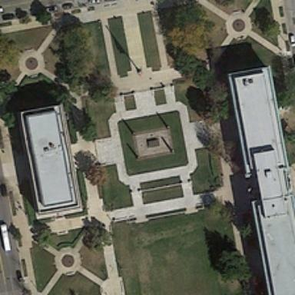
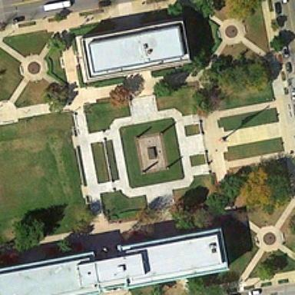
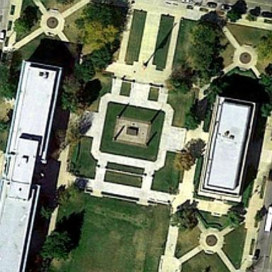
Ablation Study: Data Augmentation
Dataset limitation 10921 images, we don't just need more data, you need more variation.
Original
Variant 1
Variant 2
Prioritize Rare Words Captions using ITF
+
(8,736 images x 5 captions = 43,680 caption-image pairs) * 3
= 131040 image caption pairs
square_102.jpg
Rotate 90/270, Add Jitter,
Adjust Level & Sharpening
Flip Horizontal, Adjust Level, simulate summer sun exposure
Models | Bleu-1 | Bleu-2 | Bleu-3 | Bleu-4 | Meteor | Rouge_L | Cider | SPICE
BLIP1 | 68.09 | 50.71 | 38.65 | 30.27 | 25.79 | 47.94 | 58.64 | 26.71
After | 69.46 | 51.31 | 38.57 | 29.6 | 26.63 | 48.81 | 67.17 | 25.20
+14.5%
Presenter: Jason Widjaja (z5494973)
Notes:
1:34
3:34
5:30
7:00

Slide 27
Upgrade Architecture: Blip1 Base → Blip1 Large
 | Blip 1 Base | Blip 1 Large | Result
Vision Encoder | ViT-B/16 (86M) | ViT-L/16 (307M) | can distinguish semantic ambiguity, captures subtle details, textures, "marina" vs "harbor" vs "dock
Text decoder | BERT-base (124M) | BERT-large (340M) | richer vocabulary, more fluent, grammatically correct, descriptive captions
Total Params | 210M | 647M | 3x larger
Hidden Size | 768 - dim embeddings | 1024 - dim embeddings | 33% more information capacity, better spatial understanding, “airports next to highway”
Num Attention Heads | 12 | 16 | Better parallel spatial understanding and object disambiguation
Num Layers | 12 | 24 | 2x deeper, better deep semantic reasoning and caption fluency
Presenter: Jason Widjaja (z5494973)

Slide 28
Hard Performing Class - Blip 1 Large Caption Improvement
Image: 00867.jpg
“two huge, white circles come into view while a railway passes through aside.”
“a fan-shaped playground with two big white jars.”
“two white tanks ae near some green trees.”
“two white tanks are semisurrounded by some green plants.”
“two white storage tanks are semi-surrounded by green plants.”
BLIP1 | two white round buildings are near a road with green trees
BLIP1 + Large | two white round tanks are near a road and some green trees .
Presenter: Jason Widjaja (z5494973)

Slide 29
Finetune Result BLIP 1 - Large
+22.9%
Models | Bleu-1 | Bleu-2 | Bleu-3 | Bleu-4 | Meteor | Rouge_L | Cider | SPICE
VLAD + RNN | 49.3 | 30.91 | 22.09 | 16.77 | 19.96 | 42.42 | 103.92 | -
LAM | 4.6 | 1.78 | 0.98 | 0.62 | 9.8 | 9.67 | - | -
VIT + GPT2 | 58.32 | 34.56 | 21.18 | 13.71 | 34.13 | 33.06 | 38.46 | 21.24
BLIP1 Base | 68.09 | 50.71 | 38.65 | 30.27 | 25.79 | 47.94 | 58.64 | 26.71
BLIP1 Large | 73.87 | 57.73 | 45.84 | 37.19 | 29.99 | 53.97 | 88.22 | 29.17
SkyEyeGPT | 87.73 | 77.7 | 68.9 | 61.99 | 36.23 | 63.54 | 89.37 | -
Presenter: Jason Widjaja (z5494973)

Slide 30
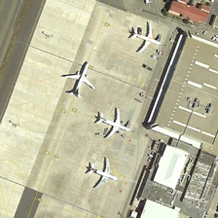
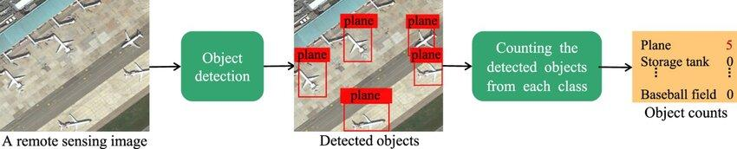
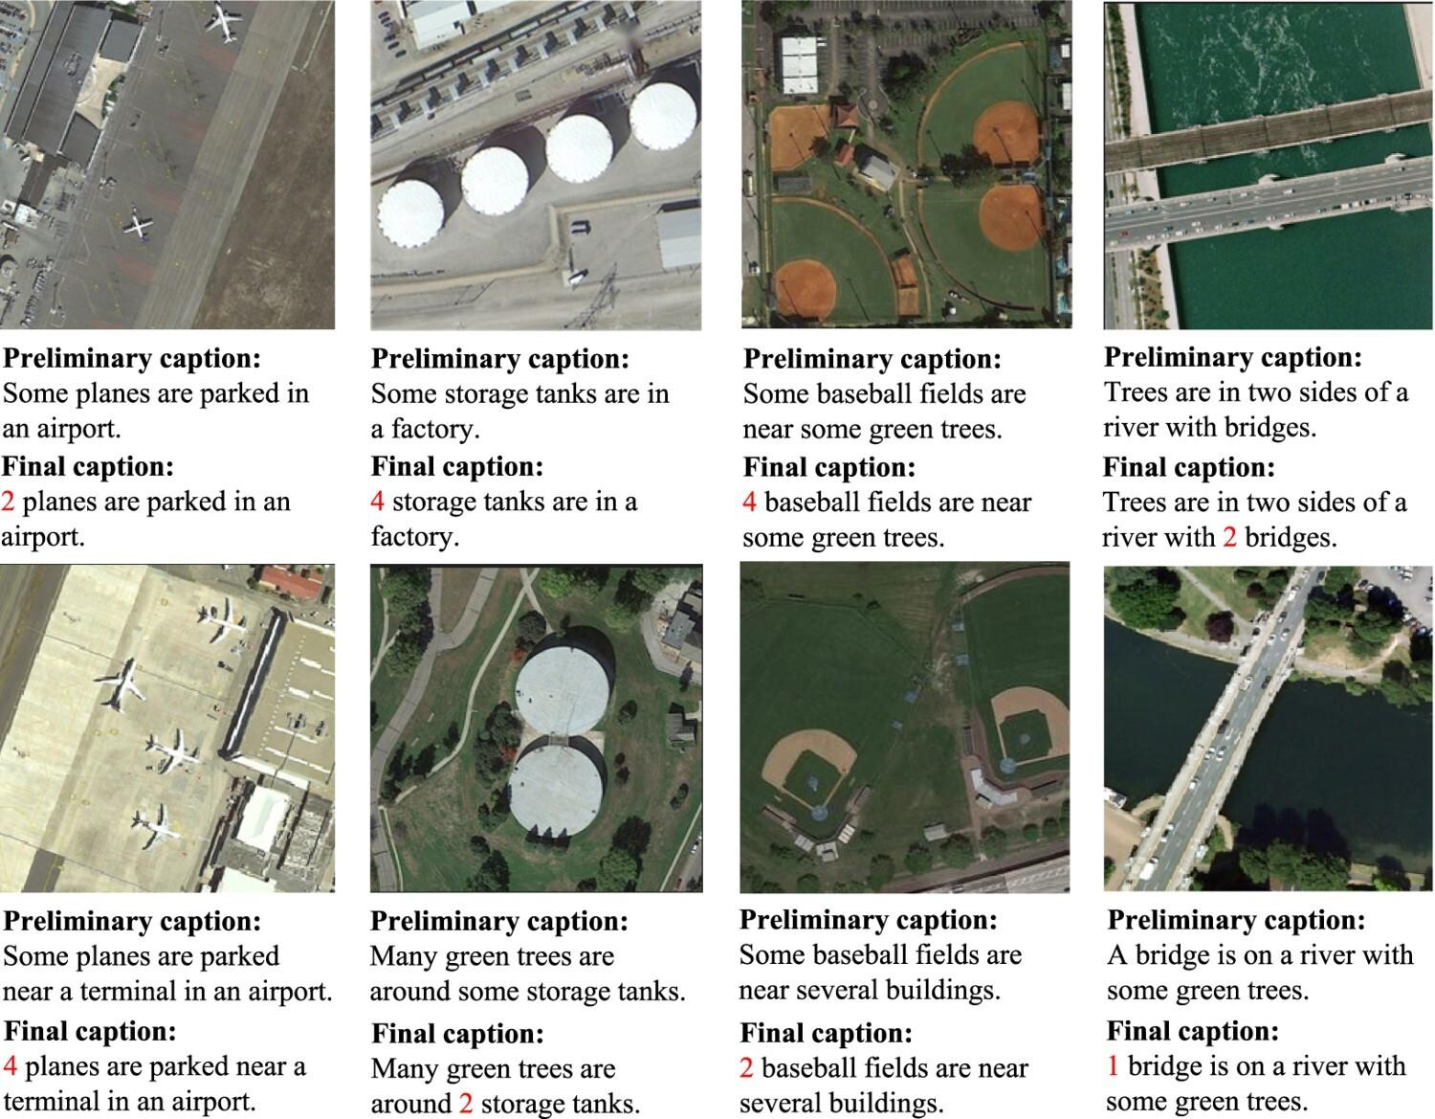
Discussion: Incorporating
object counting
Ref: https://www.tandfonline.com/doi/full/10.1080/17538947.2024.2392847#d1e305
Presenter: Jason Widjaja (z5494973)

Slide 31
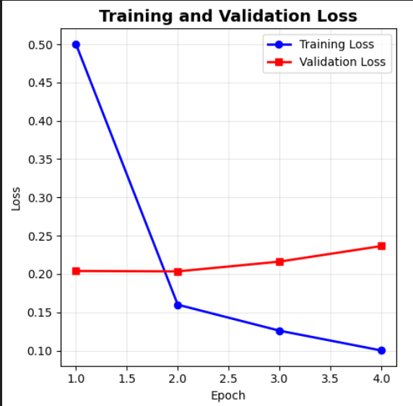
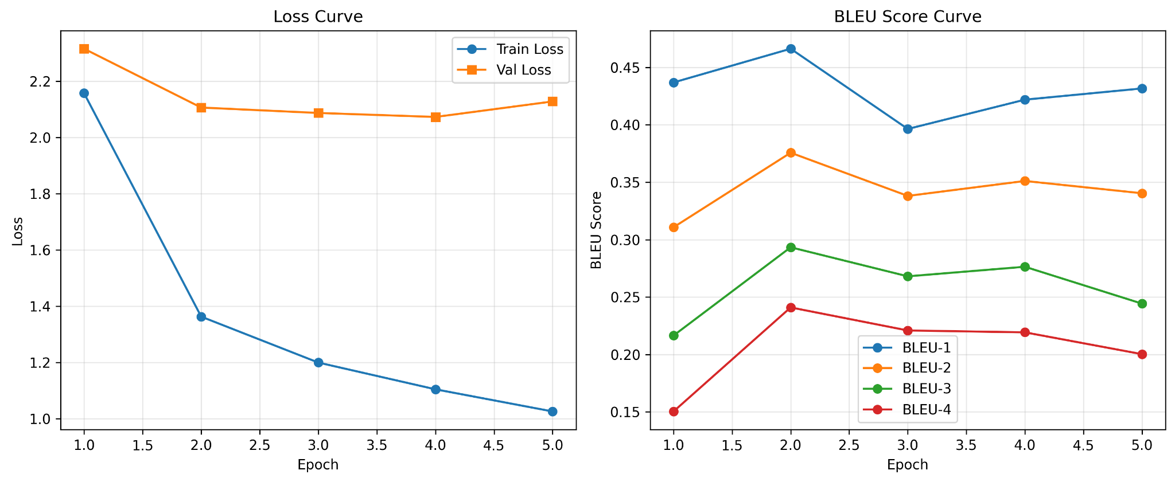
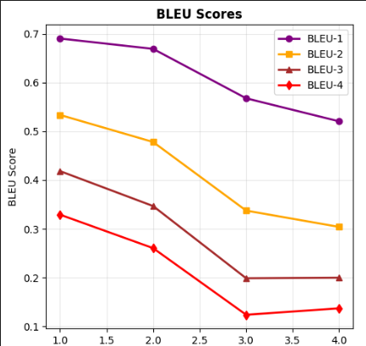
Plateau < epoch 5
ViT+GPT2
BLIP 1
Presenter: Jason Widjaja (z5494973)

Slide 32
Discussion BITA Approach, the importance of pretraining
Stage 2
Caption generation
Stage 3
Fine Tuning
Result
Write a full sentence from scratch,
based on the image
RCISD Dataset
8734 images
4 planes are parked near a terminal in an airport
VIT, pre-trained on classification
GPT2, only trained on text, no prior alignment with vision
must learn alignment and generation simultaneously during fine-tuning
Poor generalization and fluency. No shared embedding space vision-language representation.
VIT/GPT2
Presenter: Jason Widjaja (z5494973)

Slide 33
Discussion BITA Approach, the importance of pretraining
Stage 1 Alignment Phase
Caption reconstruction(MLM)
Stage 2
Caption generation
Stage 3
Fine Tuning
Result
“Some [MASK] are parked near a terminal in an airport”
Write a full sentence from scratch,
based on the image
RCISD Dataset
8734 images
4 planes are parked near a terminal in an airport
VIT, pre-trained on classification
GPT2, only trained on text, no prior alignment with vision
must learn alignment and generation simultaneously during fine-tuning
Poor generalization and fluency. No shared embedding space vision-language representation.
VIT/GPT2
Blip 1: Multitask Objectives (retrieval, VQA, captioning)
Domain Gap Pre Trained on natural images (too general),
and Vocabulary Mismatch web-scraped captions, not remote sensing data
alignment doesn't transfer well to remote sensing
Not optimised for captioning RSCID dataset is too small
BLIP1
Presenter: Jason Widjaja (z5494973)

Slide 34
Discussion BITA Approach, the importance of pretraining
Stage 1 Alignment Phase
Caption reconstruction(MLM)
Stage 2
Caption generation
Stage 3
Fine Tuning
Result
“Some [MASK] are parked near a terminal in an airport”
Write a full sentence from scratch,
based on the image
RCISD Dataset
8734 images
4 planes are parked near a terminal in an airport
VIT, pre-trained on classification
GPT2, only trained on text, no prior alignment with vision
must learn alignment and generation simultaneously during fine-tuning
Poor generalization and fluency. No shared embedding space vision-language representation.
VIT/GPT2
Blip 1: Multitask Objectives (retrieval, VQA, captioning)
Domain Gap Pre Trained on natural images (too general),
and Vocabulary Mismatch web-scraped captions, not remote sensing data
alignment doesn't transfer well to remote sensing
Not optimised for captioning RSCID dataset is too small
BLIP1
BITA: Pre Training specific for RS image–caption alignment. Creates a shared embedding space
BITA: Refine decoding and fluent captioning abilities, trains the model to generate captions autoregressive
already speaking the language of remote sensing
Fluent, accurate technical descriptions
BITA
Presenter: Jason Widjaja (z5494973)

Slide 35
Conclusion
Dataset is very small and imbalance making it difficult to train accurately, captions are often generic
Non-consensus metric evaluation, Real-World Use > BLEU
Result: Blip1 Large proved to be the better model due to it being a multi-task pre trained model on natural images, but still doesn’t have RS specialised vocab.
Fine tuning is difficult, especially adding attention to improve semantic(context). Data Augmentation doesn’t help! Need more variation.
Remote Sensing Image Captioning has big potential in understanding the spatial world especially for future robotics
Presenter: Jason Widjaja (z5494973)

Slide 36
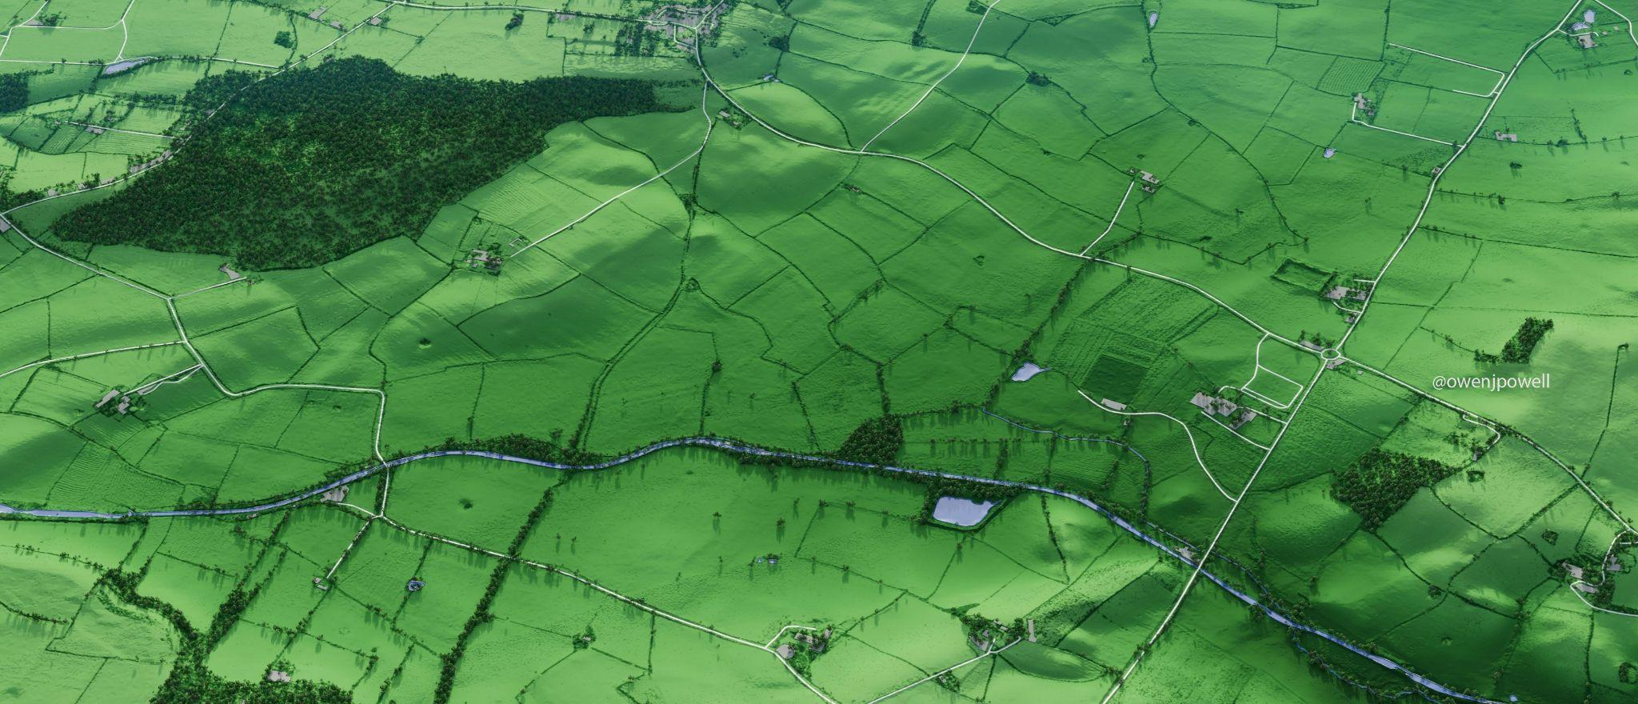

THANK YOU
Shayan Ziaei
z1234567
Revathi Sridhar Surya
z5520480
Jason Widjaja
z5494973
Sachin Singh
z5525041
Pankaj Patel z5519861

